Slide 1
Nanotechnology Challenges and Fears
Today we’ll focus on health & environmental challenges posed by nanotechnology
This will be based on “case studies” drawn from research and activist literature
For which general tone will be cautionary, or even downright negative
So before I begin, I want to offer three caveats / qualifications:
Caveat 1) All of what follows should be taken with reservations
In the spirit of sounding warnings, I have sought out alarming data
But these data are drawn largely from medical studies:
No other field takes longer, or has to work harder, to reach understanding & consensus
Because in medicine it's virtually impossible to set up the sort of single variable well controlled experiment we physical scientists have the luxury of using
A Hands-on Introduction to Nanoscience: WeCanFigureThisOut.org/NANO/Nano_home.htm

Slide 2
Caveat #2) I am not a medical or even a biological researcher
Reinforcing caveat #1's suggestion that you reserve final judgment
And emphasizing YOUR need to study further
Which I've tried to facilitate by collecting dozens of MY source papers
on the accompanying webpage: Nano Challenge and Fears - Supporting Materials
Caveat #3) Bear in mind that nano’s most POSITIVE impact may yet be in medicine!
Certain beneficial medical applications are already easy to anticipate:
Such as possible use of Buckyballs to safely contain metal MRI contrast agents
But others follow from nano's unexpected interactions with our body and cells:
For instance, evidence Buckyballs may also stimulate creation of new hair follicles
And the most dramatic may ultimately be found in nano's use for cancer treatment:
A Hands-on Introduction to Nanoscience: WeCanFigureThisOut.org/NANO/Nano_home.htm

Slide 3
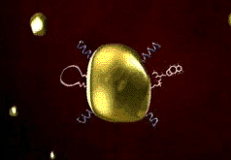
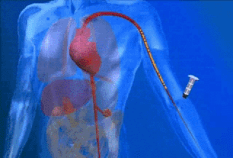
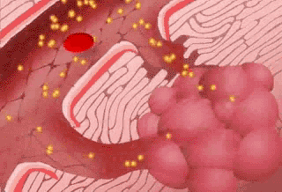
Case Study #1) Use of nano gold in chemotherapy:
From the spring 2008 business section of the Washington Post: CytImmune Inc.
One of a number of companies looking to nano for chemotherapy:
Goal: Deliver chemotherapy toxins directly (and specifically) to human tumors!
Approach?
1) Make gold nanoparticles
and attach chemotoxins . . .
2) Inject into bloodstream
3) Flawed tumor blood vessels allow gold nanoparticles to penetrate and accumulate
Supporting webpage with embedded animations:
Supporting Materials - CytImmune
A Hands-on Introduction to Nanoscience: WeCanFigureThisOut.org/NANO/Nano_home.htm

Slide 4
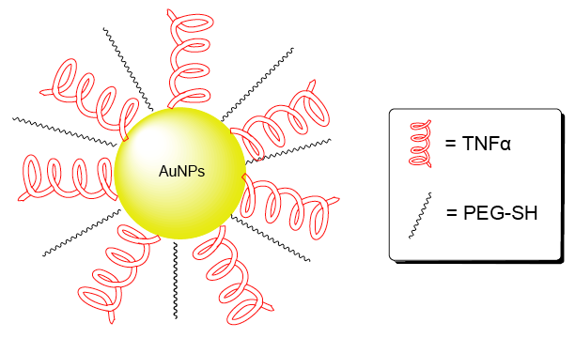
Of course, it's never quite that simple:
First, the body has mechanisms for encapsulating and eliminating foreign bodies
But many of these kick in only if object is > ~1/3 um
Likely targeting bacterial invaders
NANO particles (NPs) ARE much smaller
UNLESS they clump together!
To prevent clumping, NPs must be hydrophillic
Common trick is to add polarized surface layers or molecules
Such as poly-ethylene glycol (“PEG”)
Which, for non-reactive gold, is attached via S-H (“thiol”) groups
Then similarly attach the chemotherapy toxin: Tumor necrosis factor (TNF)
See: Chen et al. “Gold Nanoparticles from Nanomedicine to Nanosensing (link)
A Hands-on Introduction to Nanoscience: WeCanFigureThisOut.org/NANO/Nano_home.htm

Slide 5
But there is a (serious!) complication:
This toxin (and most chemotherapy drugs) is not just toxic to cancer cells!
That's why they are trying to "target" delivery
Here, by sizing gold NPs to penetrate sloppy blood vessel walls of tumors!
More generally, they're trying to target any cell exhibiting unusually rapid growth
It's why chemotherapy affects hair, lining of digestive tract and testicles
Because they contain body's most rapidly growing normal cells!
But to use really strong drugs, targeting must be almost 100% effective:
Not just to minimize "peripheral damage" but because
trace concentrations of the same toxin can INDUCE cancer elsewhere!

Slide 6
So, here, we cannot be satisfied with most of toxin-laden gold going to the tumor
Must ensure that virtually ALL chemotoxin goes to the tumor
OR is rapidly excreted
OR is rapidly degraded/metabolized
THIS is problem holding up deployment of such therapies!
But it also suggests huge, perhaps surprising, potential financial benefit:
Drug companies spend BILLIONS on ultimately "ineffective" cancer drugs
But many of these "ineffective" drugs do a great job of killing cancer cells!
Problem was that they ASLO killed healthy cells they encountered
Truly "targeted" delivery would allow companies to resurrect abandoned drugs!
Recouping their investments and (we'd hope) also saving us money

Slide 7
But the use of gold is straightforward, right?
After all:
Gold IS “golden” because of its almost complete lack of chemical reactivity
This is why, unlike silver (or other metals), gold does not tarnish or oxidize
In fact, chemists have to take very special measures to bind anything to gold
Their stock trick (used above) is to add a S-H (thiol) chemical attachment group
Lack of reactivity makes gold the first choice when need to put metal into body:
Preferred for everything from pierced earring posts to pacemaker wiring
However, in the body, it's not just about chemical reactivity
It's also about shape, and the often strange interaction of shape and chemistry
A Hands-on Introduction to Nanoscience: WeCanFigureThisOut.org/NANO/Nano_home.htm

Slide 8
How might nanoparticles acquire unexpected toxicity?
1) SURFACE TO VOLUME ratios are vastly higher for nanoparticles:
- Much larger fraction of particle’s atoms/molecules exposed to environment
- Then, if constituents are soluble in environment, will also dissolve much more quickly
What IS total surface area of 1 microgram of material with density of 3 gm /cc?
Particle Mass # of Particles Particle Diameters Total Surface Area
1 microgram 1 121 microns .0002 cm²
1 nanogram 10³ 12.1 microns .002 cm²
10⁻¹² grams 10⁶ 1.21 microns .023 cm²
10⁻¹⁵ grams 10⁹ 121 nanometers .235 cm²
10⁻¹⁸ grams 10¹² 12 nanometers 2.350 cm²
With 12 nm particle diameters, 1 microgram of material => 2.3 cm² surface area!
A Hands-on Introduction to Nanoscience: WeCanFigureThisOut.org/NANO/Nano_home.htm

Slide 9
2) QUANTUM SIZE EFFECT can alter fundamental properties
Electron standing waves are induced by confinement in particle (lecture 3)
They have altered size-dependent energies
Those altered energies dictate nanoparticle’s optical and chemical properties
3) SIZE AND SHAPE may yield new biological interactions
For instance, the above ability of properly sized
gold nanoparticles to penetrate blood tissue barrier:
But in the case of nano gold, is there ANY evidence of altered properties?
YES: Discovered in 1930's that injected colloidal gold relieved rheumatoid arthritis
Via a mechanism STILL not fully understood!
A Hands-on Introduction to Nanoscience: WeCanFigureThisOut.org/NANO/Nano_home.htm

Slide 10
Along with more recent studies on nano gold:
“Effect of gold nanoparticles on spermatozoa” (link)
Gold nanoparticles observed to penetrate into heads and tails of spermatozoa
Result: Motilty fell from 95% to 75%
Mechanism? Article didn't provide, but did note nanogold can be more reactive
Manifestation of “Quantum Size Effect” (standing waves) of lecture 3?
Also cited research on gold-induced male sterility in manufacturing environments
May seem like rather limited/specific problem
But reproductive cells can be particularly sensitive indicators: “The Canary in the coal mine”
And to the above report, add:
A Hands-on Introduction to Nanoscience: WeCanFigureThisOut.org/NANO/Nano_home.htm

Slide 11
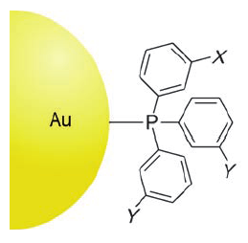
“Size-dependent cytotoxicity of gold nanoparticles” (link)
Used gold nanoparticles of varied sizes, stabilized by triphenyl phosphine ligands
“Stabilization” = enhancing solubility,
suppressing aggregation:
Exposed connective, epithelial, microphage and melanoma cells to these particles
Observed that for specific gold nanoparticles sizes:
Gold nanoparticles attached to DNA in its “major groove”
Physically obstructing DNA expression?
Gold’s triphenyl phosphine groups partially replaced DNA backbone phosphate groups
Rebuilding (a.k.a. mutating) DNA!
Wikipedia
Likely to interfere with DNA coding and/or expression!

Slide 12
Reminding us of course's title: “We're not in Kansas Anymore!”
Things (here normally innocuous gold) act VERY DIFFERENTLY at the nanoscale!!
But going back to this lecture's title:
While CHALLENGES of gold nanoparticle-based medicine are abundantly clear
In my opinion FEAR of the above emerging nanotechnology is not called for
Why? Goes back to the FIRST principle of medicine: “Do No Harm!” That is:
Risk assessment is an integral part of any investigation of medical benefit
Indeed, I easily found a rich literature on gold nanoparticle risk vs. benefit
So I'd instead reserve my personal “FEAR” category for situations
Where nanotechnology is being deployed with little or no assessment of risk!
A Hands-on Introduction to Nanoscience: WeCanFigureThisOut.org/NANO/Nano_home.htm

Slide 13
Case Study #2) Nano metal oxides in sunblock
Sunblocks traditionally consist of metal oxide powders suspended in an oil
The metal powders are chosen for ability to absorb damaging UV ranges of sunlight
Classic is zinc oxide, but many other metal oxides are also used
Such sunblocks have long been used without problems, thus judged to be safe:
Because their metals ARE already fully oxidized, they tend to be chemically inactive
And, due to the strength of oxide bonds, metal oxides do not readily dissolve
HOWEVER: When they absorb UV they can disassociate/ionize to become ROS's
(ROS's = Reactive Oxidizing Species)
Nevertheless thought "safe" because they are only put on skin surface
Skin = Body's Spacesuit: Its job is to largely isolate us from our environment
Skin surface is dead cells (therefore hard to damage)
Which are continuously shed (renewing barrier + releasing embedded chemicals)

Slide 14
But sunblocks can have a cosmetic problem:
In addition to UV light absorption . . .
Particles also scatter light of any color
Result: Powders tend to appear white (= all colors scattered)
Fine for flour, talc . . . But can look kinda weird on your face:
Solution comes right out of this class's water ripple tank labs:
When light wavelength > particle size, get far less light scattering
So reduce sun block metal oxide particles to < λ _{visible light} ~ 300 nm
Versus:
Google Images
A Hands-on Introduction to Nanoscience: WeCanFigureThisOut.org/NANO/Nano_home.htm

Slide 15
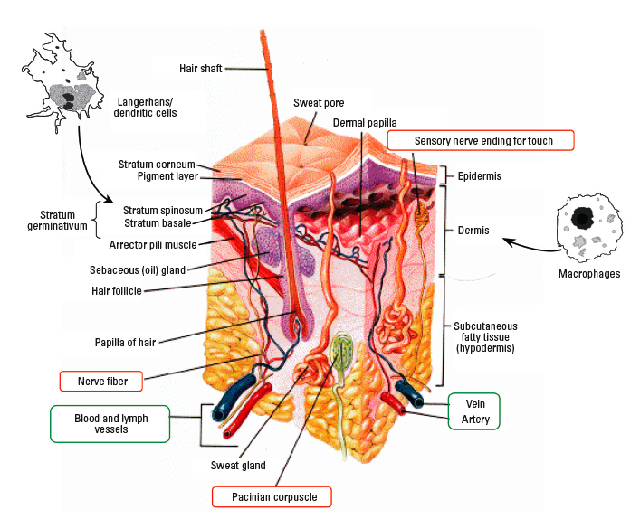
However, skin is hardly monolithic armor:
It is instead penetrated by a rich assortment of pores, glands, hairs, nerves, blood vessels . . .
From Oberdorster et al. (link)
A Hands-on Introduction to Nanoscience: WeCanFigureThisOut.org/NANO/Nano_home.htm

Slide 16
So can we assume that skin blocks nano metal particles?
Classic assessment: Scotch Tape removal of deeper and deeper skin cell layers
Then analyze successive tape pieces for presence of metal in question
For nanometal sunblocks, detectable metal signals quickly diminish to zero
But the key (often ignored) word is “detectable”
However, for instruments using electrons and photons to analyze intact samples:
I know, from personal experience, that sensitivity is likely no better than 0.1 to 1%.
For better sensitivity must have significant 3D volume of sample, and take it apart:
As done in mass spectroscopies or chromatographies that actually count atoms/molecules
Likely that Scotch Tape analysis is limited to 0.1 - 1% surface analysis techniques
So “undetectable metal oxide skin penetration” may ONLY mean < 1 part per 1000
A Hands-on Introduction to Nanoscience: WeCanFigureThisOut.org/NANO/Nano_home.htm

Slide 17
But “less than one part per thousand” sounds pretty low
Concentrations may not stay low if metal oxides make it into the blood stream
At that point metal oxides could end up anywhere in body
And, most importantly, size, shape or chemistry, could drive local accumulations
In which case there are, again, reports of possible cell damage:
- Studies by EPA showing that nano TiO₂ affected mice immune cells (link)
- Other reports of metal oxide cell mitochondrial damage or even DNA mutation (link)
But don't I need to balance these possible risks against the near certainty of developing possibly fatal melanoma if I don't use sunblocks? Absolutely!
And anyway, in this case, as a consumer don't I have a simple personal option?
A Hands-on Introduction to Nanoscience: WeCanFigureThisOut.org/NANO/Nano_home.htm

Slide 18
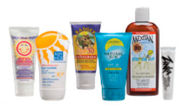
To play it safe just avoid nano sunblock brands! (right?)
Then along comes the December 2008 issue of Consumer Reports (link):
Tested six sunblocks specifically claiming they contained no nano sunblock ingredients
For which CR tests showed all but one DID contain nano zinc oxide or nano titanium oxide
Are vendors just lying to consumers?
Or is it possible they are ignorant about ingredients?
Such ignorance would have seemed unlikely
At least until recent rash of news stories on product adulteration, in particular:
Melamine in pet foods & baby formulas to inflate tested protein content
Similar offshore adulteration of sunblocks to enhance UV blocking values?
(Over last decade, FDA & Consumer Product Safety Commission have been essentially silent!)
A Hands-on Introduction to Nanoscience: WeCanFigureThisOut.org/NANO/Nano_home.htm

Slide 19
So I put nano sunblock on my “Fears” list
NOT because there IS strong evidence of current hazard:
Existing evidence of skin penetration IS weak
Existing evidence of biological toxicity IS limited
But we DON’T have better data because proper testing has not been done!
So my first reason for “fear” (or at least caution) is lack of information
Second reason for fear/caution is near total lack of control:
Nano metal oxides have been widely introduced into sunblocks, without labeling
Even when labeled non-nano alternatives appeared, CR tests indicate false labeling
So as a consumer I am left with inadequate information AND inadequate control!!
A Hands-on Introduction to Nanoscience: WeCanFigureThisOut.org/NANO/Nano_home.htm

Slide 20
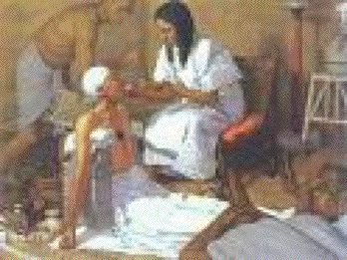
Case Study #3) Nano silver impregnated plastics
Even the ancients knew that silver could have antibacterial & antifungal effects
It's why (at least the richest of them) used it for wine and water storage
Also why they used it to treat syphilis and gonorrhea
And led them to think that a silver coin held in
the mouth might hinder infection by plague
Many (too many?) explanations for antibacterial effects – A leading candidate:
"Denaturing" (unfolding) of cell membrane/wall proteins as insertion of silver ions
cleaves the hydrogen bonds that pulled different parts of the protein together
And if silver ions thereby manage to get inside the cells:
Metal ions can bind to phosphate groups on DNA
And to many other inter-cellular chemicals, blocking their function
A Hands-on Introduction to Nanoscience: WeCanFigureThisOut.org/NANO/Nano_home.htm

Slide 21
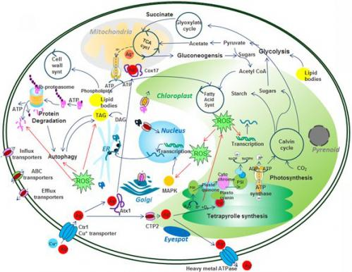
And silver has surprisingly strong/quick effect upon aquatic bacteria
= Key constituents of the aquatic / wetland ecosystems upon which we depend!
These cells naturally metabolize copper
Thus readily absorb it through their cell walls
Silver is so similar it can exploit same pathways
Concentrating it 1000 fold inside cells!
Inside cell it can poison cell's photosynthesis
Photosynthesis rate cut in HALF after just 15 minutes exposure to DILUTE Ag!
Could easily be similar effects in soil bacteria (necessary for our food growth)!
Paper: Linking toxicity and adaptive response . . . (of bacterium) exposed to silver

Slide 22
And now add in the modern paranoia about GERMS (!!!!):
www.oralabs.com/blog/hand-sanitizer-vs-soap-and-water/
A Hands-on Introduction to Nanoscience: WeCanFigureThisOut.org/NANO/Nano_home.htm

Slide 23
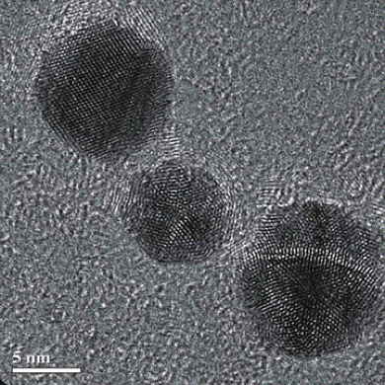
The free market response?
Manufacturers have found ways to embed nano silver spheres in plastics:
Source: http://www.pfonline.com/articles/090701.html
And where have they ALREADY used such nano silver impregnated plastics?
A Hands-on Introduction to Nanoscience: WeCanFigureThisOut.org/NANO/Nano_home.htm

Slide 24
Where you can expect to find nanosilver in YOUR life:
In things you wear
In things you ingest
In things to “look good”
In things you touch
Sheets & pillows
Towels
Fabrics
Uniforms
Sports shirts
Hats & gloves
Underwear
Condoms
Hearing aids
Socks & Slippers
Shoe inserts & cleaner
Foot bath massager
Fabric softeners
Laundry balls
Laundry additives
Soaps & detergents
Washing machines
Water purifiers
Vegetable cleaner
Toothpaste
Toothbrush
Denture cleaner
“Health” supplements
“Health” drinks
Food storage containers
Dishware
Frying pans
Teapots
Cutlery handles
Kitchen cutting boards
Kitchen cleaners
Refrigerators
Air filters & humidifiers
Air masks
Air conditioners
Hair dryers
Hair brushes
Make-up brushes
Curling irons
Shavers
Razors & blades
Cosmetics
Shampoos & soaps
Wipes
Vaginal gel
Nanbabie™ clothing
Pacifiers & teething toys
Baby bottles
Bottle brush cleaner
Baby strollers
Children’s plush toys
Baby antibacterial spray
Cell phones
Laptop PCs
Computer peripherals
ATM buttons
Elevator buttons
Doorknobs & handrails
Telephones
Lamps
Watches
Vacuum cleaners
Paper
Paints & Inks
Pet food & water bowls
Pet water purifier
Pet spray
Pet Shampoo
In things for your baby
In things for your pet
Source: Appendix to the Center for Technology Assessment's petition to the EPA (link)
A Hands-on Introduction to Nanoscience: WeCanFigureThisOut.org/NANO/Nano_home.htm

Slide 25
Why should I worry about a fungicide / bactericide?
Because for for truly selective toxicity you generally need complexity
Complexity => uniqueness (e.g. hormones that lock a specific insect in larval form)
But silver's biocidal mechanisms (slide 18) are instead likely to be very NON-specific
Besides, early GERM exposure strengthens immune system / suppresses allergies
Medical researchers call this the “Hygiene Hypothesis” – as reported in Smithsonian Magazine (2013):
The Unintended (and Deadly) Consequences of Living in the Industrialized World
"At birth, our immune cells make up an aggressive army with no sense of who its enemies are. But the more bad guys the immune system is exposed to during life’s early years, the more discerning it gets. The immune system is programmed within the first two years of life. With less early infection, the immune system has too little to do, so it starts looking for other targets.”
The article describes:
- Genetically equivalent populations living on both sides of the Finnish/Russian border
- Russians are poorer, receive inferior health care, and are less healthy in almost all respects
EXCEPT they have lower rates of asthma, allergies, diabetes and other autoimmune disorders

Slide 26
And do we even need bactericides?
Simple soaps offer a viable alternative:
Soap is NOT just a means of enhancing removal, it’s also a biocide
Surfactants mix polar & non-polar => dissolution in water
INCLUDES breaking down “bilipid” cell membranes of GERMS
It’s why getting soap INSIDE your protective skin layer can be such a bad idea!
A Hands-on Introduction to Nanoscience: WeCanFigureThisOut.org/NANO/Nano_home.htm

Slide 27
We've already lost control of where nano silver ends up
It's thus VERY likely we are already ingesting nano silver (possibly in quantity)
That is why public interest groups such as the Center for Technology Assessment and the Natural Resources Defense Fund have petitioned EPA to invoke FIFRA:
FIFRA = Federal Insecticide, Fungicide or Rodenticide Act
Application of FIFRA would require testing of product for both efficacy and safety
But at this time, EPA invokes only if vendor uses specific terms in labels or ads:
Don't use words “insecticide,” “fungicide” or “rodenticide” and you are in the clear!
Last time I checked, EPA had fined only ONE manufacturer for use w/o testing:
Parent company of IOGEAR computer peripherals fined $208,000 in March 2008
Despite what appears to be obvious appropriateness of applying FIFRA standard!
A Hands-on Introduction to Nanoscience: WeCanFigureThisOut.org/NANO/Nano_home.htm

Slide 28
And so nanosilver TOO ends up on my “Fears” list
Even though, as in earlier examples, I don't claim strong proof of harm
It's instead, once again, due to:
1) A near complete lack of information, based on absence of appropriate testing
2) And lack of any personal control (widespread deployment without labeling)
But, as with earlier example, “caution” may again be a better word than “fear”
To get well into the fear category, need something more like the following:
A Hands-on Introduction to Nanoscience: WeCanFigureThisOut.org/NANO/Nano_home.htm

Slide 29
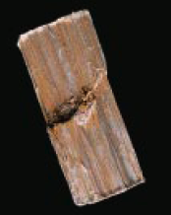
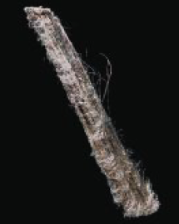
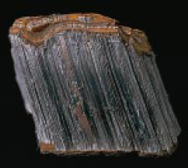
Case study #4) Asbestos and possible nanotube parallels
Asbestos is a class of mineral fibers of made from Si, Mg, Fe, Ca and Al oxides
Includes a variety of names and structures, with straight or curly fibers, e.g.:
“Amosite” “Chrysolite” “Crocodolite”
The commercial attraction of asbestos was its apparent inertness:
Ended up being used in consumer products including even toothpaste
But its outstanding application was as fireproof insulation
At least until workers started dying of particularly virulent cancers!
For an introduction, see the Scientific American article from which these figures are drawn (link)
A Hands-on Introduction to Nanoscience: WeCanFigureThisOut.org/NANO/Nano_home.htm

Slide 30
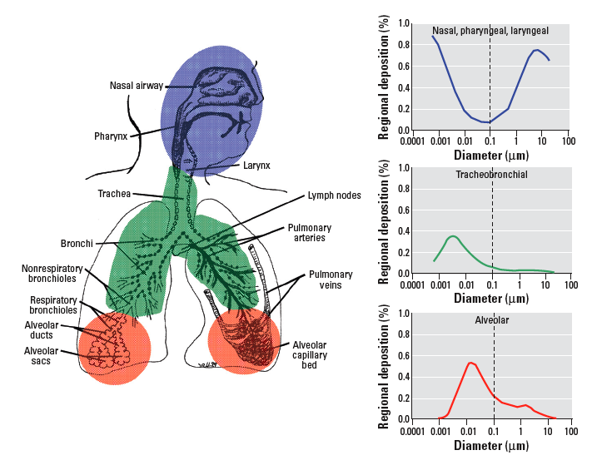
Toxicity is related to where fibers come to rest in human body:
And that resting place depends on the fiber’s size and shape:
Oberdorster et al.: "Nanotoxicology: An Emerging Discipline Evolving from Studies of Ultrafine Particles" Environmental Health Perspectives, vol. 113, p. 823, 2008 (link)
A Hands-on Introduction to Nanoscience: WeCanFigureThisOut.org/NANO/Nano_home.htm

Slide 31
Even at particular location, toxicity is shape/size dependent:
Asbestos Fiber length
Fiber diameter
Source: Phillip M. Cook - National Health & Environmental Effects Research Laboratory (link)
A Hands-on Introduction to Nanoscience: WeCanFigureThisOut.org/NANO/Nano_home.htm

Slide 32
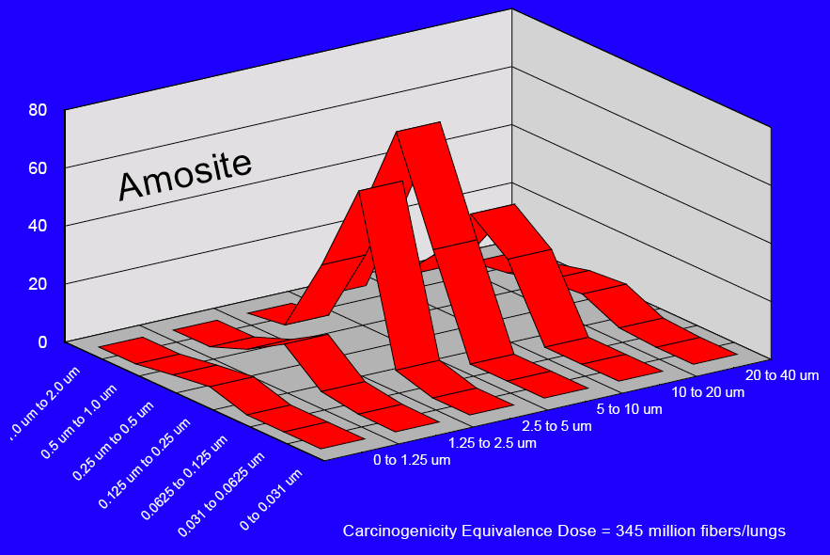
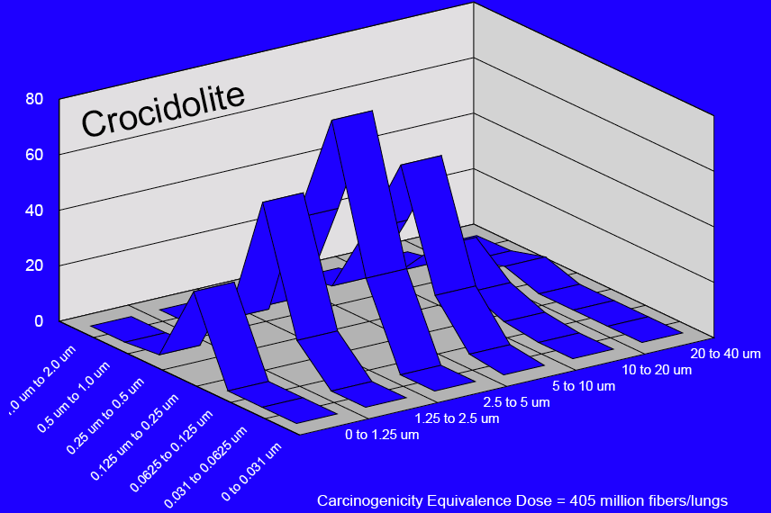
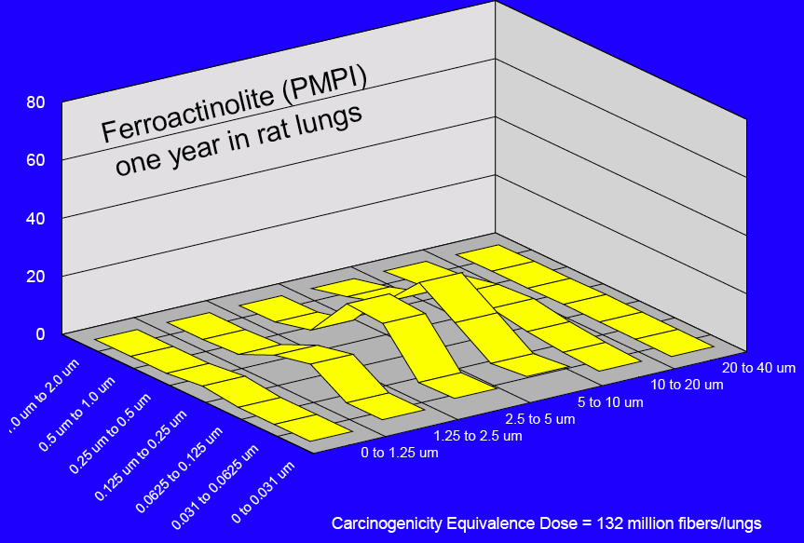
And can be differentiated by particular asbestos fiber:
Source: Phillip M. Cook - National Health & Environmental Effects Research Laboratory (link)
A Hands-on Introduction to Nanoscience: WeCanFigureThisOut.org/NANO/Nano_home.htm

Slide 33
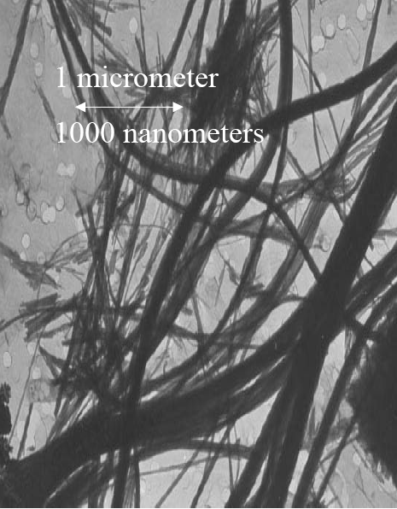
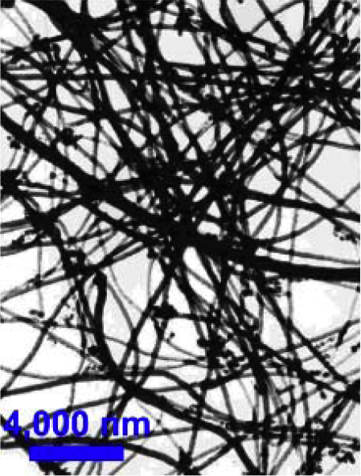
Why bring up the subject of asbestos?
Because shape similarities between asbestos & carbon nanotubes can be striking:
Chrysotile Asbestos: Carbon nanotubes:
Source: Phillip M. Cook - National Health & Environmental Effects Research Laboratory (link)
A Hands-on Introduction to Nanoscience: WeCanFigureThisOut.org/NANO/Nano_home.htm

Slide 34
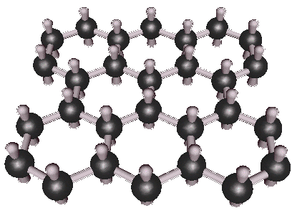
But asbestos toxicity ALSO depends on its surface chemistry:
Studies on animals and cell cultures indicate that embedded asbestos:
Generates reactive oxygen and nitrogen species
That are known to damage proteins and DNA
See: “Multiple Roles of Oxidants in the Pathogenesis of Asbestos-Induced Diseases” (link)
But remember possible “free-radical” like behavior of graphitic planes? (lecture 7)
Electrons perpendicular to plane can pair to form resonant bonds
OR as unpaired electrons could act as oxidizing “free-radical” sites
Conceivably producing similar oxidative damage to proteins and DNA
Any experimental confirmation? Possibly:
A Hands-on Introduction to Nanoscience: WeCanFigureThisOut.org/NANO/Nano_home.htm

Slide 35
“Carbon nanotubes that look like asbestos behave like asbestos”
TEM of Fibers
SEM of Tissue
SEM
X-section
Tangled Asbestos
Straight Asbestos
“Carbon nanotubes introduced into the abdominal cavity of mice show asbestos like pathogenicity in a pilot study”
C.A. Poland et al., Nature Nanotechnology (2008) (link)
Tangled Nanotube
Straight Nanotube
A Hands-on Introduction to Nanoscience: WeCanFigureThisOut.org/NANO/Nano_home.htm

Slide 36
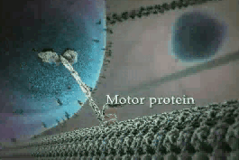
But why are only certain cells sensitive to certain nanofibers?
Remember those strange spheres being hauled around the interior of cells?
From Harvard University's "The Inner Life of the Cell" animation
(as shown in last lecture)
A Hands-on Introduction to Nanoscience: WeCanFigureThisOut.org/NANO/Nano_home.htm

Slide 37
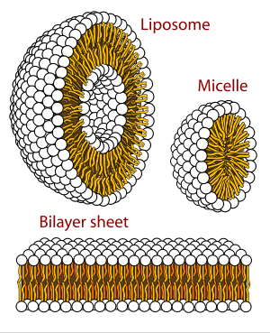
They are the cell's internal cargo containers:
From Wikipedia on "Lipid Bilayers"
Liposomes:
Hydrophillic outer and inner surfaces
=> carry polar molecules
Micelles:
Hydrophillic outer / hydrophobic inner surface
=> carry non-polar substances
Can be formed when cell wants to haul in from outside a thing that is either too big or too polar to pass through the cell's membrane
Cell identifies these wanted "things" via chemical receptors on its exterior
A Hands-on Introduction to Nanoscience: WeCanFigureThisOut.org/NANO/Nano_home.htm

Slide 38
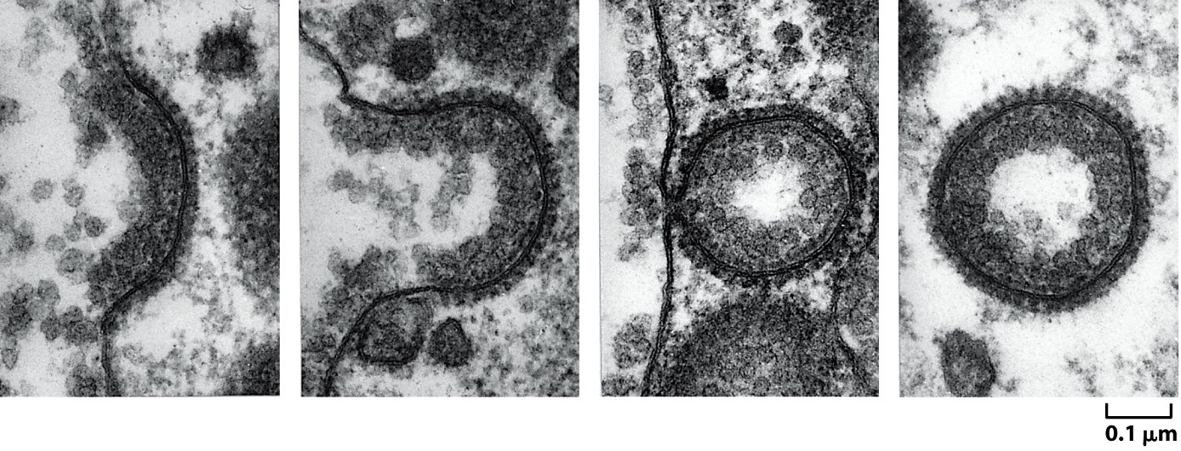
Process is called "endocytosis" – looks like this:
Fig 13.48 – "World of the Cell" – Alberts et al.
Exocytosis => <= Endocytosis
RELEVANCE?
Negative surface of ASBESTOS binds to serum protein vitronectin that, in turn, binds to receptors on surface of mesothelial and lung epithelial cells
And CARBON NANOTUBES are thought to bind directly to lectin cellular receptors
Initiating endocytosis – Despite fact that cell is too small to "swallow" a nanotube!

Slide 39
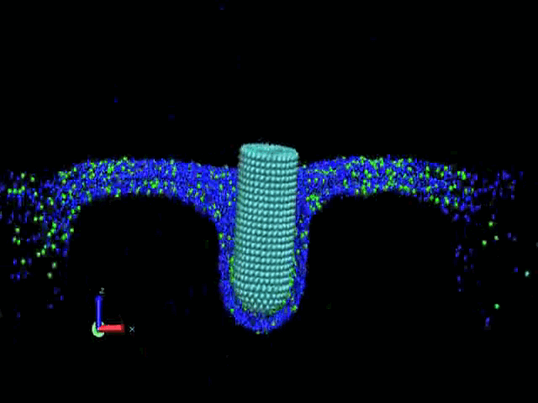
Computer simulation of resulting cellular indigestion:
“It's as if we would eat a lollipop that's longer than us - it would get stuck.”
Huanjian Gao, Professor of Engineering, Brown University, discussing his paper
"Entry of one-dimensional nanomaterials occurs by tip recognition and rotation"
Nature Nanotechnology, September 2011
=> Sustained oxidative stress => Inflammation => Mutations =>Cancer
A Hands-on Introduction to Nanoscience: WeCanFigureThisOut.org/NANO/Nano_home.htm

Slide 40
So I put this into my full “Fear” classification
Especially as asbestos-induced cancers can take 20-30 years to show up!
AND there are claims that cancer could result from as little as one exposure
Classic anecdote is of person who once changed asbestos-laden auto brake pads/shoes
So asbestos’ terrible toxicity would not have shown up in normal testing!!!
Raising possibility that carbon nanotubes could pass reasonable tests
But still, far down the road, turn out to be dangerous
So what CAN one reasonably do? Help skin and lungs do their protective jobs!
Protect them from nanoparticles with combinations of size & shape known to penetrate
Or from nanoparticles with combinations of size & shape they have difficulty expelling
Suggesting we may want to be really careful with certain sizes of carbon nanotube!
A Hands-on Introduction to Nanoscience: WeCanFigureThisOut.org/NANO/Nano_home.htm

Slide 41
But where ELSE might nano toxic materials go?
To this point we've take a selfishly human-centric viewpoint:
It's fine if it doesn't hurt me or (being cautious) penetrate me!
But that is hardly the end of the story:
There is that thing called the environment, a.k.a. all other living organisms
Sizes/shapes that don't penetrate our bodies might easily penetrate other organisms
Indeed many of the readings for this lecture provide evidence of this
And if organism is a simple cell, we've seen it's very vulnerable to nanotoxic effects
A Hands-on Introduction to Nanoscience: WeCanFigureThisOut.org/NANO/Nano_home.htm

Slide 42
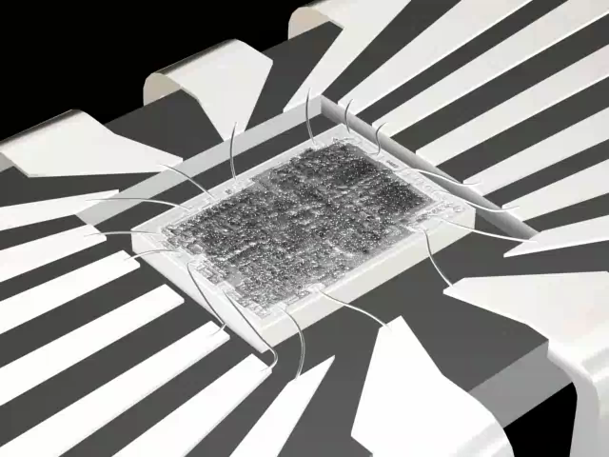
And nano containment is a BIG potential challenge
Nanoparticles are easily carried on the winds and through the waters
May even be possible that they'd percolate out of landfills through soil
That was not possible with predecessor micro technology!
I've spent a career making micro/nano dimension things
But when I got done, they went into something like this:
A cm² sized chip, with inert SiO₂ surface
There were, of course, real issues with safety of manufacture and its wastes
But when manufacture was complete: Was fairly easy to conclude product was safe
And/or that the product was going nowhere other than where we last left it!
A Hands-on Introduction to Nanoscience: WeCanFigureThisOut.org/NANO/Nano_home.htm

Slide 43
With containment being such a challenge, what are we doing?
We are putting nano metal oxides into sunblocks
That we then wash off our bodies
and send into our water systems
We are embedding nano silver particles throughout our plastics
Where they can dissolve or dislodge
from surfaces into our environment
And we are gearing up to reinforce automobile tires with carbon nanotubes
Label I found on my kitchen wastebasket!
A Hands-on Introduction to Nanoscience: WeCanFigureThisOut.org/NANO/Nano_home.htm

Slide 44
This last possible application is a real gem:
Carbon nanotube reinforced tires:
- Should be stronger than "steel belted radial" tires
- And also lighter (and thus likely more fuel efficient)
But what happens when tires are used? Their tread wears away!
Top 1/4 inch or so of rubber seemingly "disappears" – But to where?
Rubber becomes fine powder distributed all around our highways and roads
Right into your own front yard!
Could "Doctor Evil" have imagined a better scheme for covering the earth
with possibly carcinogenic CNT's?

Slide 45
Can it / should it be stopped?
I am a post WWII baby boomer who later became a physicist
So from two directions I heard the soul searching on nuclear weapons development
“Someone is going to do it - so it better be us” was the favorite justification
But, for better or worse, it also seemed to represent cold-hearted reality
From this, and the broader history of technology, I conclude:
Nano IS going to be pursued somewhere, REGARDLESS of our local beliefs, laws . . .
And from the science (e.g. nano-fluidics) I conclude:
Even if “somewhere” is far away, will be impossible to contain once loose in environment
So we ARE going to live with it. We should at least do so with our eyes wide open!
A Hands-on Introduction to Nanoscience: WeCanFigureThisOut.org/NANO/Nano_home.htm

Slide 46
For nanotechnology:
Revise consumer product laws that now assume safety until proven otherwise
Move instead towards food and drug like requirement of up front safety testing
As the Europeans are now doing!
Demand labeling of nano containing products (allowing for some personal choice)
Revise health & environmental laws now naively based on only total mass exposure
Instead take into account particle size and effects due to surface area enhancement
1 gm of carbon charcoal being safe, doesn't prove 1 gm of carbon nanotubes are safe !
Put some fraction of the governmental funds going into nano, into nano safety
This HAS been proposed but strongly opposed (including by scientists wanting every $)
Closely monitor particularly vulnerable cells & species (recalling experience with DDT)
In general: Act cautiously, particularly where we have viable alternative technologies
A Hands-on Introduction to Nanoscience: WeCanFigureThisOut.org/NANO/Nano_home.htm

Slide 47
Credits / Acknowledgements
Funding for this class was obtained from the National Science Foundation (under their Nanoscience Undergraduate Education program).
This set of notes was authored by John C. Bean who also created all figures not explicitly credited above.
Copyright John C. Bean
(However, permission is granted for use by individual instructors in non-profit academic institutions)
A Hands-on Introduction to Nanoscience: WeCanFigureThisOut.org/NANO/Nano_home.htm

